Slide 1

Customer Shopping Behavior Analysis
Uncovering insights for strategic business decisions.

Slide 2


Project Overview & Goals
Analyze 3,900 Purchases
Uncover Key Insights
Transactional data across diverse product categories.
Spending patterns, customer segments, product preferences.
Guide Business Decisions
Optimize operations, enhance customer engagement.

Slide 3

Dataset Summary: Key Features
Data Volume
Shopping Behavior
3,900 Rows, 18 Columns.
Discount, Promo Code, Previous Purchases, Frequency, Review, Shipping.
Customer Demographics
Age, Gender, Location, Subscription Status.
Missing Data
37 values in Review Rating column.
Purchase Details
Item, Category, Amount, Season, Size, Color.
Goal
Comprehensive understanding of customer journey.

Slide 4
Exploratory Data Analysis (Python)
01
02
Data Loading & Exploration
Missing Data Handling
Pandas import, df.info(), .describe() for structure and stats.
Imputed Review Rating with median per product category.
03
04
Column Standardization
Feature Engineering
Renamed to snake_case for readability.
Created age_group and purchase_frequency_days.
05
06
Data Consistency
Database Integration
Dropped redundant promo_code_used column.
Loaded cleaned data to PostgreSQL for SQL analysis.

Slide 5






SQL Analysis: Key Business Insights
Revenue by Gender
High-Spending Discount Users
Male vs. Female customer revenue comparison.
Customers using discounts, spending above average.
Discount-Dependent Products
Top 5 Products by Rating
Top 5 products with highest discounted purchases.
Highest average review ratings identified.
Subscribers vs. Non-Subscribers
Shipping Type Comparison
Average spend and total revenue comparison.
Average purchase amounts: Standard vs. Express.

Slide 6
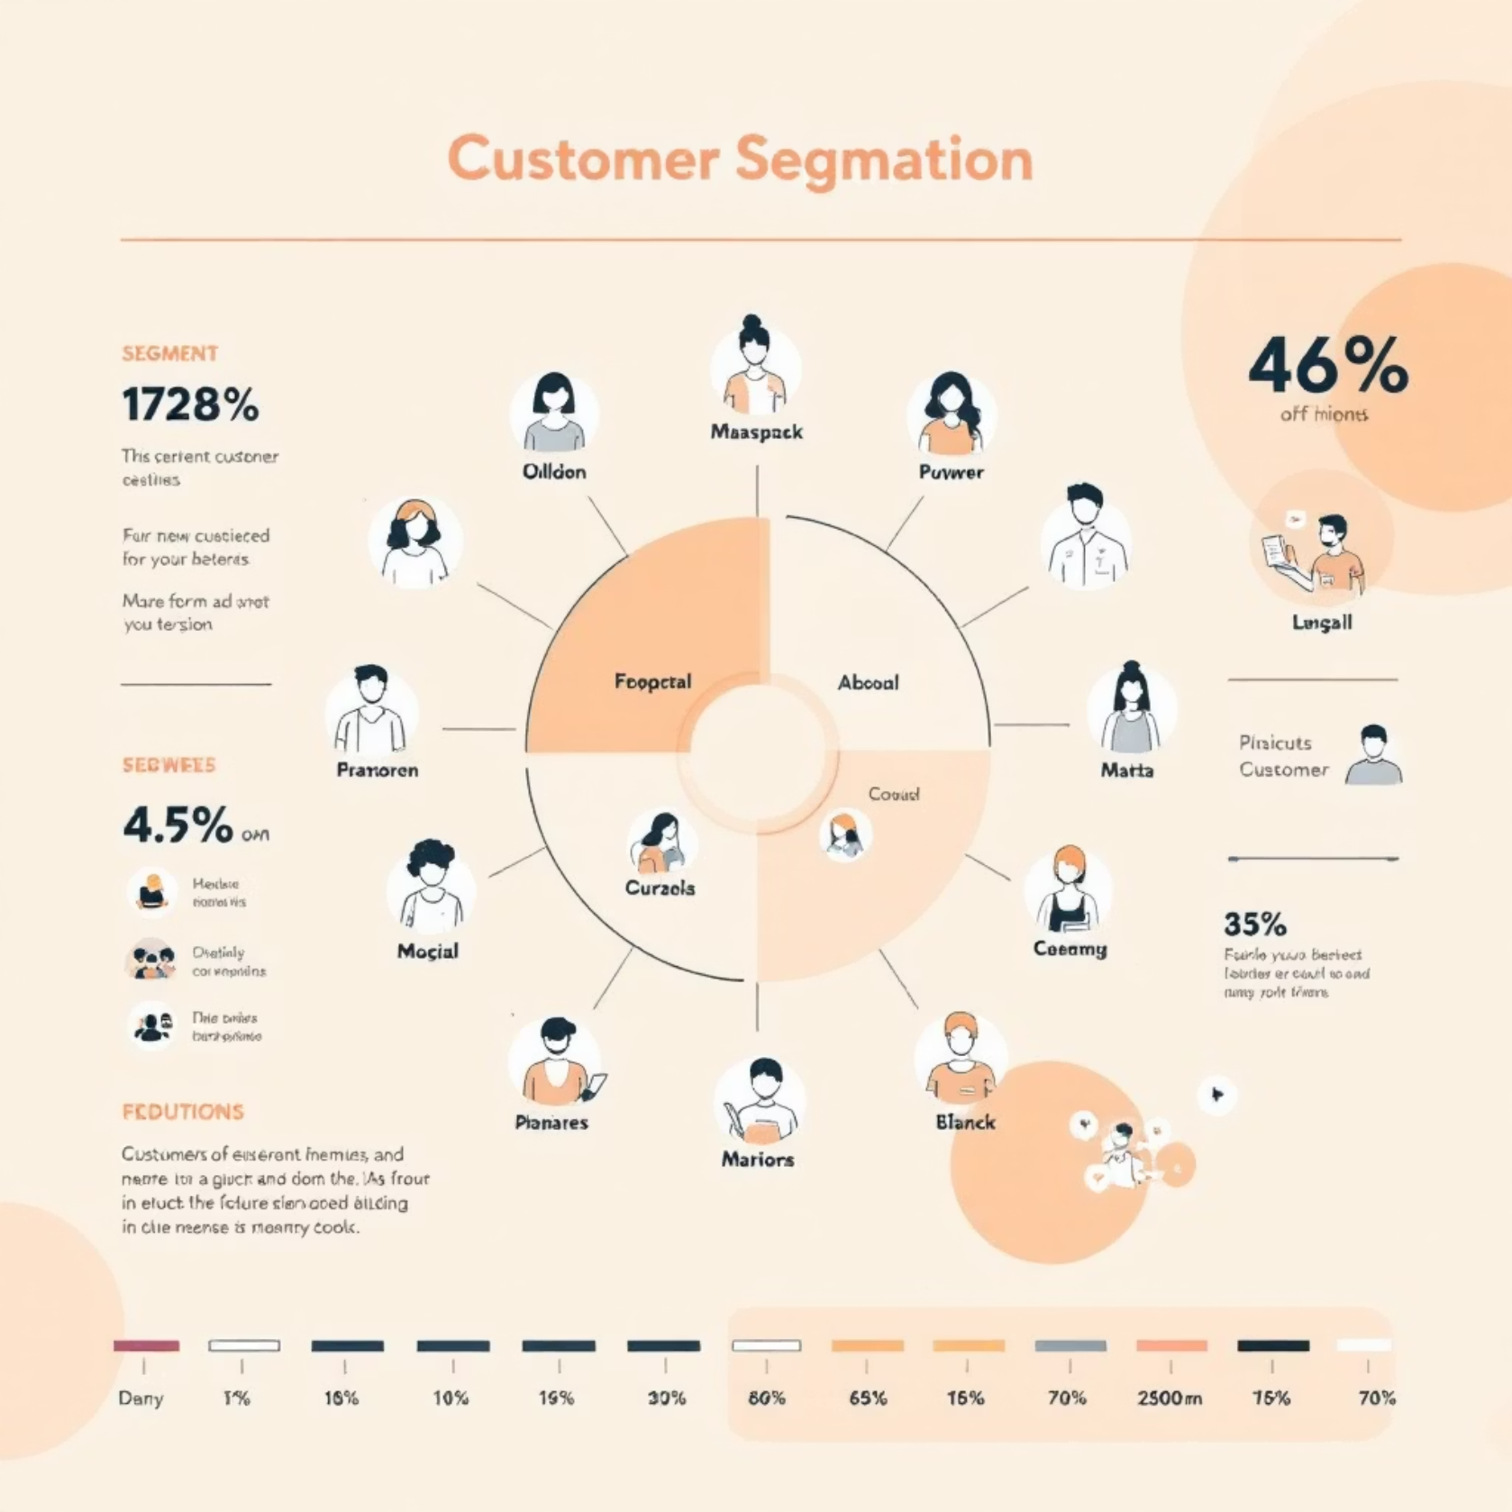
Customer Segmentation & Product Insights
1
Customer Segmentation
New, Returning, Loyal segments based on history.
2
Top 3 Products per Category
Most purchased items within each category.
3
Repeat Buyers & Subscriptions
Likelihood of subscription for >5 purchases.

Slide 7
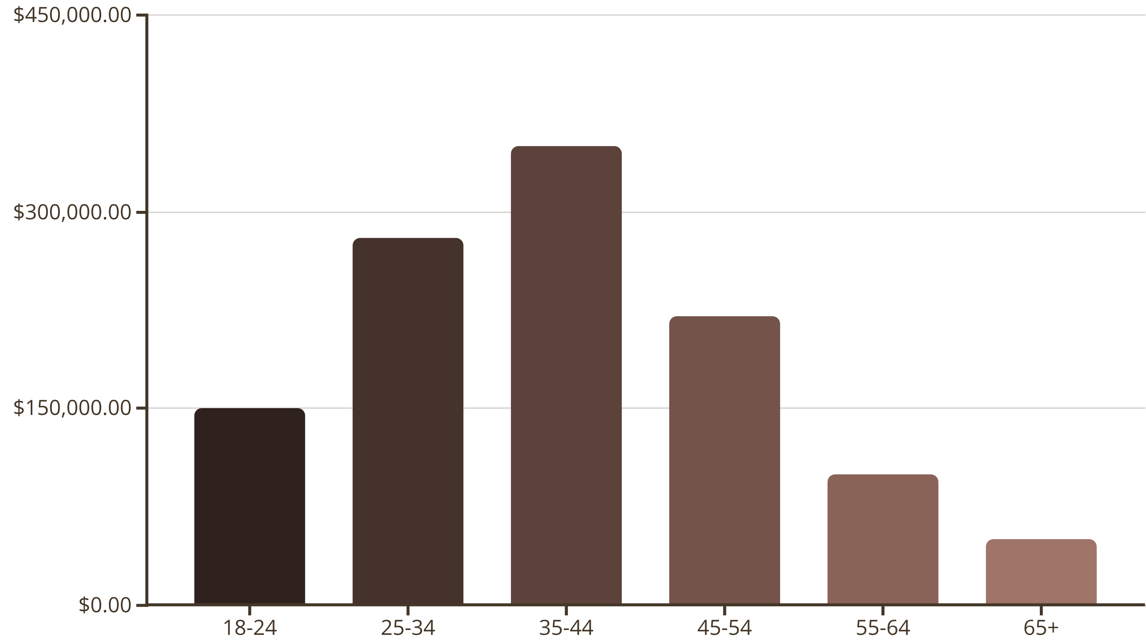
Revenue by Age Group
Understanding the total revenue contribution from each age demographic.

Slide 8
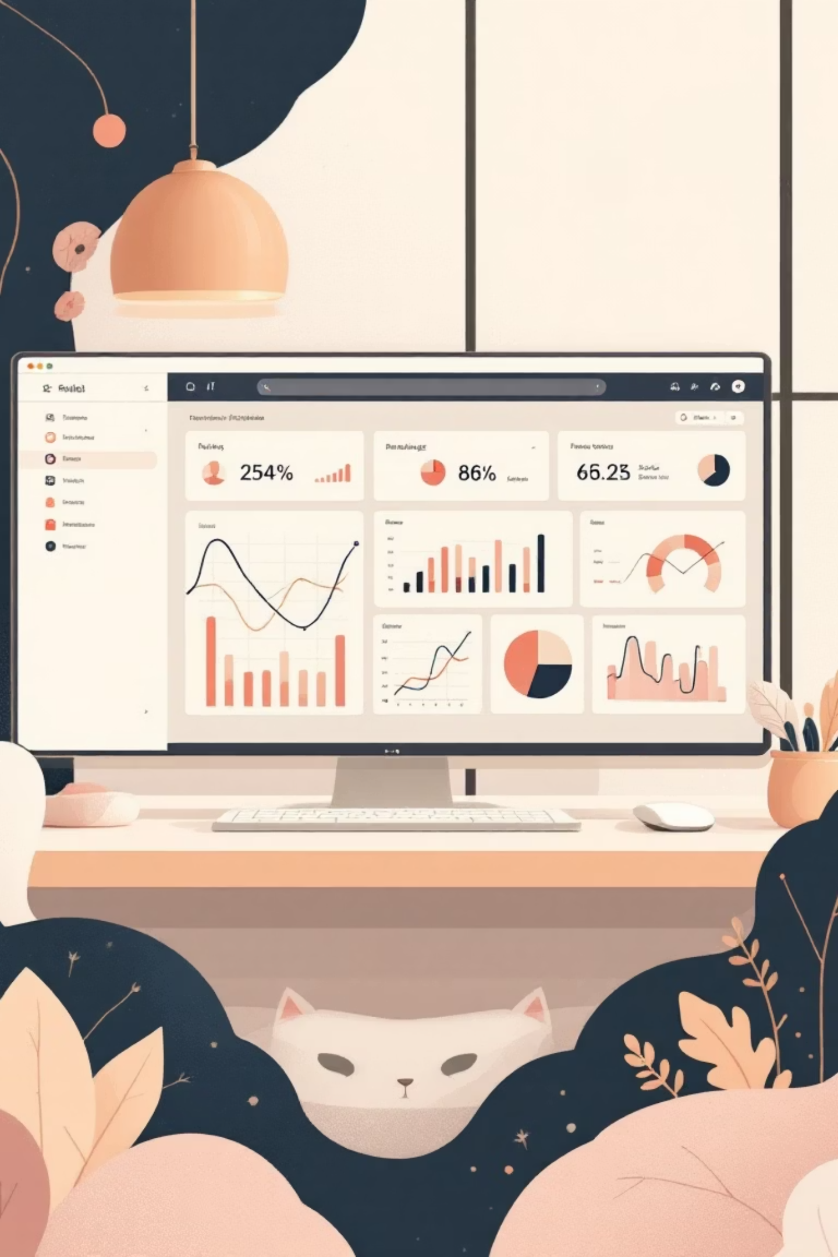
Interactive Dashboard in Power BI
Visualizing insights for easy comprehension and decision-making.

Slide 9
Business Recommendations: Strategic Growth
Boost Subscriptions
Customer Loyalty Programs
Review Discount Policy
Promote exclusive benefits for subscribers.
Reward repeat buyers to foster loyalty.
Balance sales boosts with margin control.
Product Positioning
Targeted Marketing
Highlight top-rated and best-selling products.
Focus on high-revenue age groups and express-shipping users.

Slide 10

Future Outlook
Leveraging data to drive continuous improvement and customer satisfaction.

